Slide 1
Media and
Messaging

Slide 2
Does your local communicate to key audiences on a regular basis?

Slide 3
How would you describe the effectiveness of communications at your local?

Slide 4
What tools or channels does your local use?
How to you measure effectiveness?

Slide 5
What do your members need to know?
What additional things do members want to know?

Slide 6
What does the public need to know about your local and the work you do?

Slide 7
What needs improvement in your communications?

Slide 8
Lack of communication within a union can seriously weaken unity in purpose and direction and consequently lower the effectiveness and outcomes you are trying to achieve.

Slide 9
24/7 World of News and Information

Slide 10
Convergence
Communications is Being Blended
Needs are Growing Everyday
Emerging Tools Moving Fast
Must Integrate All Tools and Work
Old Ways will No Longer Work

Slide 11
Key Types of Communications
Internal/Organizational
Public Relations/External
Political/Public Affairs
Advertising
Marketing

Slide 12
Goals for Today
  Planning is Key
  Organizational Messages
  Understand Message, Connection and Tools
  How to Talk to Members
  How to Talk to Public

Slide 13
Define Objectives
Your objectives are the key to the success of your communications strategy.
Objectives should ensure that your communications strategy is organizationally driven rather than communications driven.
Your communications activity is not an end in itself, but should serve and hence be aligned with your bigger wants and needs.
Aligning your communications and organizational objectives will also help to reinforce the importance and relevance of communications and thereby make a convincing case for the proper resourcing of communications activity.

Slide 14
Goals/Objectives
What do you want to accomplish?
Goals – High Level
Objectives – Tasks to Reach Goal
Make Them Measureable

Slide 15
Communicating
Doesn’t Equal Understanding
Effectiveness

Slide 16
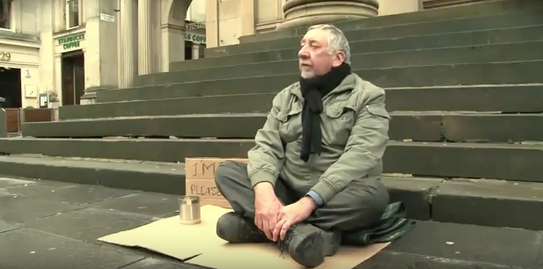

Slide 17
Change the Words
Change Your Perspective
Expand the Vision

Slide 18
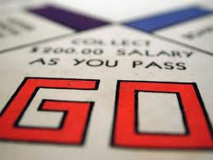
Getting Started…
Where do you begin when starting a communications program???
Planning process and team key

Slide 19
Forming Your Comms Team
Need to Have Leadership Position Run Team
Team Members
  Good Communicators
  Go Getters
  Plays Well With Others
  “The Mayor of ......”
  People Who Take Orders
Skill Sets
  Media Background
  Computer Expert
  Graphics
  Shirt/Banner/Sign Makers
  Photo/Video Specialists
  Fundraisers
  Organizers

Slide 20
Communicate with a Purpose

Slide 21
Reasons
Communicate to Position Brand/Union
Communicate for Politics
Communicate for Power
Communicate for Community Understand

Slide 22
What is
Strategic Communications?

Slide 23
Strategic Communications
Infusing Communication Efforts With an Organizational Agenda/Master Plan
Promoting Your Organization’s Brand
Educating to Key Topics
Urging People to Take Specific Actions
Advocating a Particular Political Position

Slide 24
Organizational Communication
Must Integrate Into All Union Activities
Can’t Be After Thought
Don’t Wing It
Should Identify Person for Roles
Budget Resources $$$$$
Make it a Priority/Get Leadership Support

Slide 25
Communications Defined?
Pronunciation: kə-ˌmyü-nə-ˈkā-shəns
Technique for Expressing Ideas/Issues Effectively
Process by which Information is Exchanged
Tools/Technology of the Transmission
Common System of Symbols, Signs, Behaviors

Slide 26
A Visual View Communications
  A
  B
A common mistake people make is to focus on the delivery of information, rather than how it is received.
Communication must be two-way.
Notes:
P

Slide 27
What is Communications?
Planned Use of Messages/Tools
Shape Opinion/Generate Opinion
Evaluate and Influence Attitudes
Two-way Communications
Activate Audiences

Slide 28
Playing the Communications Game
PRO-ACTIVE
Positive
Agenda Setting
Takes Offensive
IN-ACTIVE
Spectator
Sidelines
Non-player
RE-ACTIVE
Defensive
Negative
Responding
Vulnerable (VR)

Slide 29
Communication Happens
•Whether you have a plan or not Communications happens
•If you want your communication to be effective, a communication plan should be an integral part of your plan.
•Every issue that a union faces includes an element of communication.

Slide 30
Purpose of a Communications Plan
Proactive
Coordinated
Maintains Focus
Accountability
Discipline
Deadlines/On-Time
Engaged (with the right audiences)
Informed
Prepared
Feedback Tools

Slide 31
Developing a Communications Plan
Analysis/Research
Goal Setting
Planning
Communications
Feedback
Evaluation
Modification

Slide 32
Communications - A Visual View
Analysis
Feedback
Evaluation
Modification
Goal Setting
Planning
Communications

Slide 33
Format Your Communications Plan
Objective
Targeted Audiences
Messages
Tools
Timeline/Calendar
Evaluation Matrix

Slide 34
Considerations
Resources
Understanding of Filters – Barriers to Achieving Your Goal
Message Delivery Vehicles – Picking the Right Tool for the Right Audience

Slide 35
Responsive Communication Plan
Take Opportunities
  Breaking News
  Federal, State & Local Issues
  Use the Calendar/Events
Prepare for Attacks
  Self Research
  Response Language

Slide 36

Audiences

Slide 37
ID’ing Audiences
Properly identifying and understanding the target audience is the essential elements in planning a communications program.
Target audiences are best understood through specific research resulting in demographic and psychological profiles of the audiences.

Slide 38
Audience Questions
Who / where are they (demographics)?
How do they obtain daily information?
Who are their role models?
What are their current perceptions, knowledge, needs, wants, preferences, and behavior in relation to the issue addressed by the campaign?

Slide 39
Understanding You Audience
Values/What are they
Attitudes/Positive or Negative
Issues/What is important
Desires/What do they want

Slide 40
Key Audience
Employers
Potential Employers
Public/Consumers
Media
Members
Other Labor Unions
Policy Makers/Elected Leaders

Slide 41
Who is Our #1 Audience?

Slide 42
The Message

Slide 43
It’s All About Message
“Effective unions take the time to do their research, develop their messages, write that message into their plan, and then base all communications from that message.”

Slide 44
Message 101
“Message” is one of those words that is often used – and often misused.
Message is what you want your audience to remember.
It should be appealing, interesting, clear, concise, effective and compelling.
Should always have a Call to Action!

Slide 45
What is Message?
A message is a brief statement of the reason people should support your union or issue.
It is a single substantive idea or theme that becomes the central touchstone for every communication.
It is the primary tool used for motivating the targets.
It is positive and proactive, value-based, and truthful.

Slide 46
Message Discipline
Repeat your message over and over and over -- with mind-numbing regularity.

Slide 47
Don’t Ignore the Value of Your Brand
What is it?
Position with Public
Highlight Everything
Be Aggressive
Tell Stories

Slide 48
Intensity Factors
Real People/Humanize
Analogies/Comparison
Statistics/Numbers
Absolutes Statements
Assertions
Personal Experience
Expert Opinion
Colorful language
Testimonials

Slide 49
Message Motivators
Profit
Pride
Convenience
Control
Safety
Sex
Hope
Trust
Social Acceptance
Comfort
Knowledge
Order
Variety
Fear
Patriotic

Slide 50
Message Hierarchy
If you could say one thing (a single sentence) that you hope people will remember forever and repeat often. What would you say?
If you discovered you had time for a second sentence, what would you add?
For some reason – you get a chance at adding a third sentence. What’s next. And so on…..

Slide 51
Message Visual
The 5 W’s and the H
Important Material
Less Important

Slide 52
What are your Messages?

Slide 53
Messages
Growth, Strength, Prosperity
Skills, Safety, Professionalism
Training Trust
Advancing Careers
Keep People Safe and Healthy
Giving Employers No Choice but Picking Best
New Tools/Everywhere
http://iatse.net
http://iatse.net/news/ilca-save-the-met

Slide 54
Example
IATSE LOCAL UNIONS RATIFY 2015-2018 PRODUCER-IATSE BASIC AGREEMENT
Tuesday, August 25, 2015
The 13 local unions representing over 43,000 members of the International Alliance of Theatrical Stage Employees, Moving Picture Technicians, Artists and Allied Crafts (IATSE) working in motion picture and television production have ratified the new Producer-IATSE Basic Agreement with the Alliance of Motion Picture and Television Producers (AMPTP).
“The new contract represents significant gains and continued security for the welfare and livelihood of the members it covers,” said IATSE International President Matthew D. Loeb.
The contract is the labor agreement between the major motion picture and television producers and the IATSE. Key provisions of the 2015-2018 Basic Agreement include annual wage and pension increases, and no cuts or increased costs to the participants of the health plan. Substantial improvements in working conditions for new media productions are also a key part of the agreement.

Slide 55
Example
IATSE LOCAL 461 REACHES AGREEMENT WITH FIRSTONTARIO PERFORMING ARTS CENTRE
Wednesday, August 12, 2015
ST. CATHARINES, ON – On August 12, 2015, the first-ever agreement between IATSE Local 461 and the FirstOntario Performing Arts Centre was ratified.
It was approximately five years ago that the City of St. Catharines began discussions on constructing a new performance venue and Brock University quickly partnered with the city on the initiative. Local 461, which represents stage crew and allied crafts in the Niagara Region, already had an agreement in place for stage workers at Brock University. Local 461 was able to expand their existing jurisdiction at Brock University to cover workers in the newly-built Centre, and work with the City to craft a deal specific to the new Centre’s specific operational needs. The members of Local 461 are looking forward to working in this beautiful new facility and contributing to the success of this new endeavor.
The performing arts centre will be key to revitalizing downtown St. Catharines and has added an important new cultural attraction to the region. The centre features a 775-seat concert hall and a 210-seat dance/theatre venue. There is also a 300-seat recital hall and a 187-seat film venue, both of which will have shared access with Brock University’s Marilyn I. Walker School of Fine and Performing Arts. The FirstOntario Performing Arts Centred will open to the public on October 8 for its inaugural season.

Slide 56
We Are Under Attack

Slide 57
Selling
IATSE’s
Value
Tips for Your Locals to Understand

Slide 58
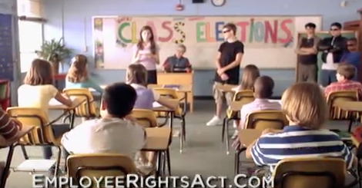

Slide 59
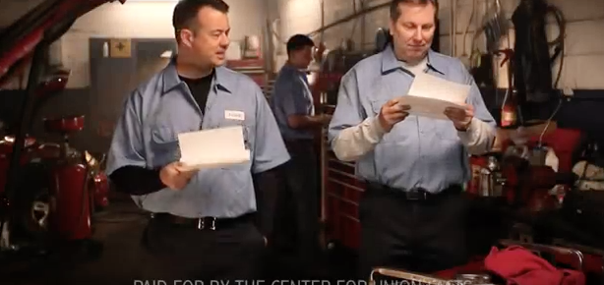

Slide 60
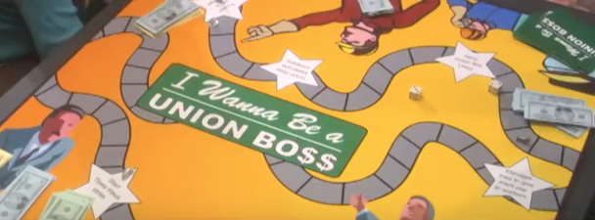

Slide 61
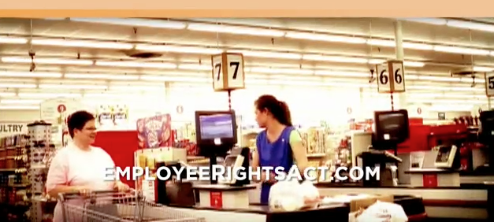

Slide 62
Don’t Assume …
…that members will remain in the union and will engage if we don’t communicate with them.
…that just because someone doesn’t participate in the union they would never get involved.
...that someone who never asked questions of the union could not be persuaded to take a leadership role.

Slide 63
Internal Communications
Boosts morale, helps create happier members who are more productive, and allows leadership to develop ambassadors for the union.
Most victories for unions are because of rank-and-file participation.
The recipe for a strong, successful union is membership involvement.

Slide 64
All union activities should be well-publicized. No union member should be allowed the excuse of, “I didn’t hear or see a word about it.”

Slide 65
“I communicate, but the members don’t pay attention…they don’t care.” local union president

Slide 66
What are your dues?
What are you selling?
What is the value?

Slide 67
The Current Situation
A considerable amount of work the union does is not visible.
Most members don’t attend union meetings.
The workplace is a breeding ground for rumors.

Slide 68
More than 80 percent of voters said that "working people" have too little influence, but only 20 percent said "labor unions" do.

Slide 69
By 2 1/2 to 1, voters said that unions care only about their own members, not about the interests of working people generally.

Slide 70
Asked who makes decisions in unions, more people say "the union" does than said that "the members" do.

Slide 71
A majority of workers said they would vote for an "employee association."
In focus groups, nonunion working people explained the distinction: many see a "union" as an outside institution that has its own agenda and thrives on conflict, while an "employee association" would be controlled by workers themselves and would be focused on resolving problems rather than creating them.

Slide 72
Most union communication aggravates labor's top-down, special interest image, instead of combating it.

Slide 73
The Union
The Membership

Slide 74
Most unions' efforts to communicate with members fail to apply the research about what members want & respond to.

Slide 75
In every communication with the public, we make choices – how an issue is framed who are the spokespeople what visual images are presented what tone is used

Slide 76
Questions to Ask
Is issue framed to highlight the connection to the broad public interest? or to emphasize only the particular needs of the union or its members?

Slide 77
Questions to Ask
Are workers, family members, and community allies featured as spokespeople……. or
is all the talking done by union officials who the public perceives as representing narrow, institutional interests?

Slide 78
Questions to Ask
Are event locations, signs, slogans, and chants chosen to emphasize the public interest connection, or just union militancy?

Slide 79
Questions to Ask
Is the tone chosen to show workers taking a stand for the community interest --- open to reasonable solutions, or is the union demanding what it wants, or else?

Slide 80
Union presidents/business managers hold news conferences or issue news releases -- without worker or community spokespeople -- to announce the organization's contract "demands" based on what the members "deserve," with little or no reference to the public interest.

Slide 81
Union picket lines typically feature chants provided by the union that have been around since the 1930s and that provide no public interest.
"We are the union, the mighty might union; everywhere we go, people want to know, who we are, so we tell them…" or "The boss says cutback, we say fight back.”

Slide 82
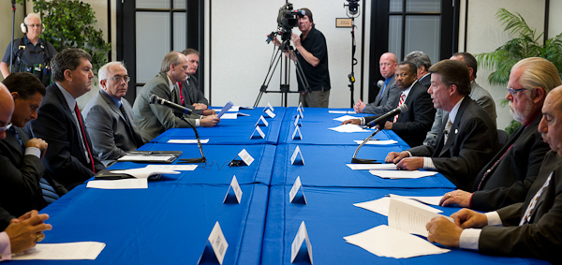
Common visual
image of Collective
Bargaining -- a table
where union leaders
in suits reach
across to shake hands to
open bargaining or to
complete a settlement with corporate executives, also in suits.
What should the public think?

Slide 83
Bargaining is about the institutional interests of the union and the company -- not about issues that affect working people and their communities.
Answer

Slide 84
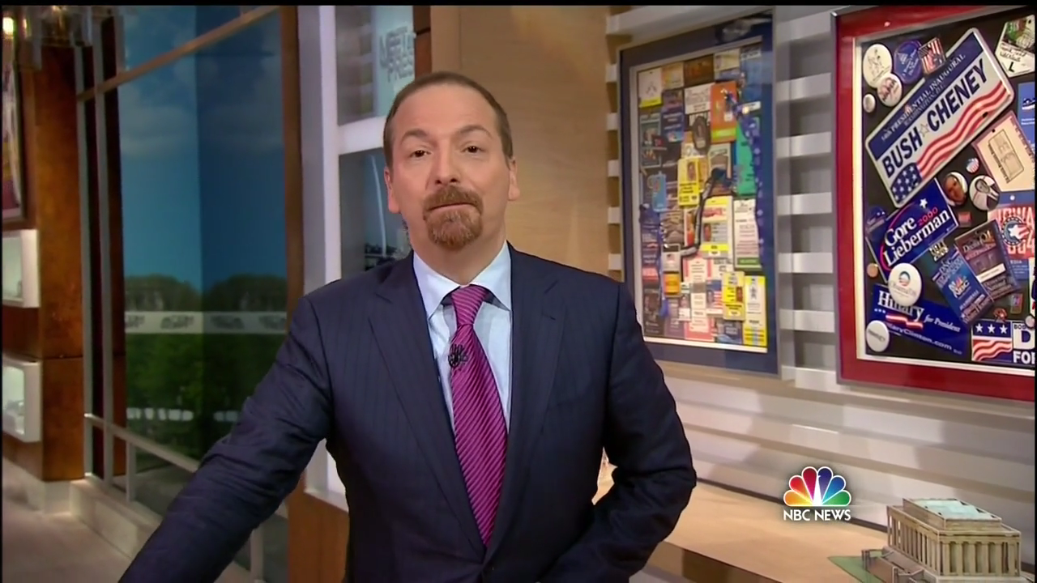
Members are a Special Club

Slide 85
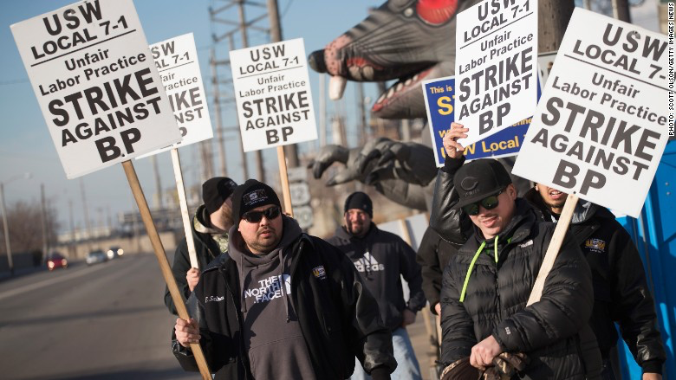

Slide 86
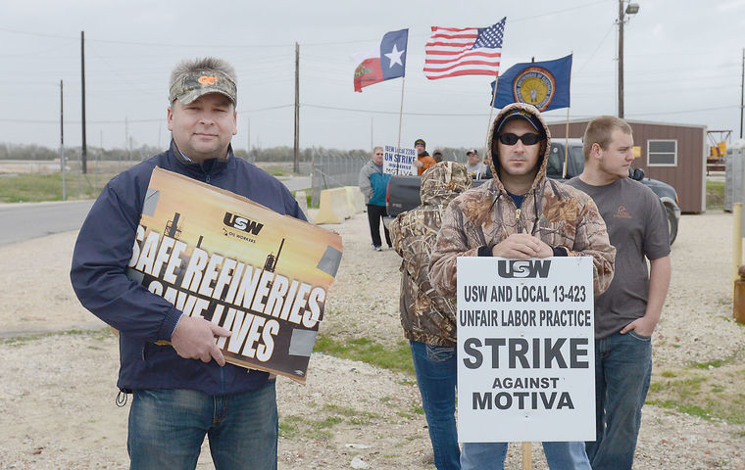

Slide 87
Words Matter
Reuters Reports…..The union wants a contract that will address issues including wages, a ratification bonus, shift differentials, which means more money for nightshifts, outsourcing what formerly was union work to outside contractors, health care, worker fatigue and retrogression, which means losing ground compared with the expired contract.
We can reframe this from jargon to things the public understands. First, we should always point out what the workers want, not what the union wants. The union is the third party and they seem greedy. This can done done by your spokesperson being aware of the words they are using.

Slide 88
POOR PERFORMANCE RIPS OFF BACKSTAGE ARTISTS AND CONSUMERS

Slide 89
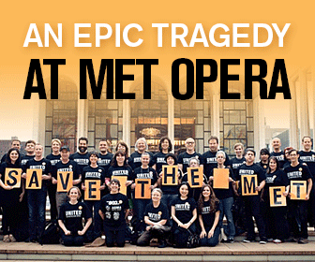
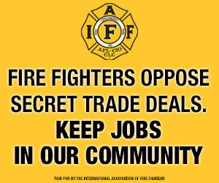
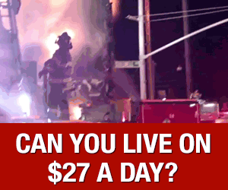
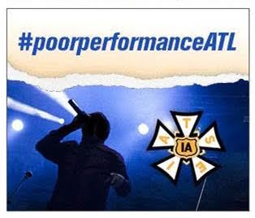

Slide 90
A lot of reporters/people don't know basic facts about labor, and anti-union forces have a powerful PR machine tirelessly working to insert anti-union language into the media as "neutral" language.

Slide 91
Hot Words of Opponents
Big Labor
Unions/The Union
Union Bosses
Strike
Corrupt Unions
Dues
No Voice
Closed Shop
Merit Shop
Pensions
Right to Work
Employee Rights Act
Spoiled Workers/Privileged Workers
In Pocket of Political Leaders
Lazy/Underworked
Costly
Anti-Competitive

Slide 92
Our Words
Professionals
Training
Association
Retirement Accounts
Middle Class Families
Everyday People
Ordinary People
Hard Working
Setting a Standard
Rising the Tide
We should all have
Community Responsibility
Job Secutiry

Slide 93
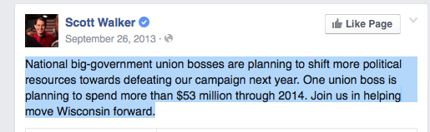

Slide 94
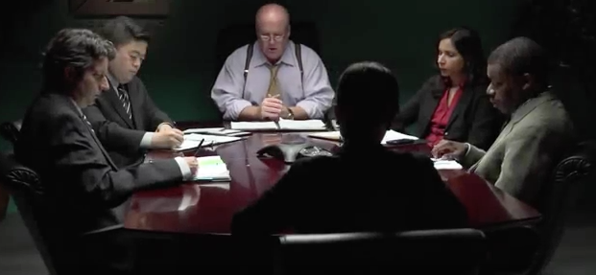
What Have Unions Done

